Slide 1

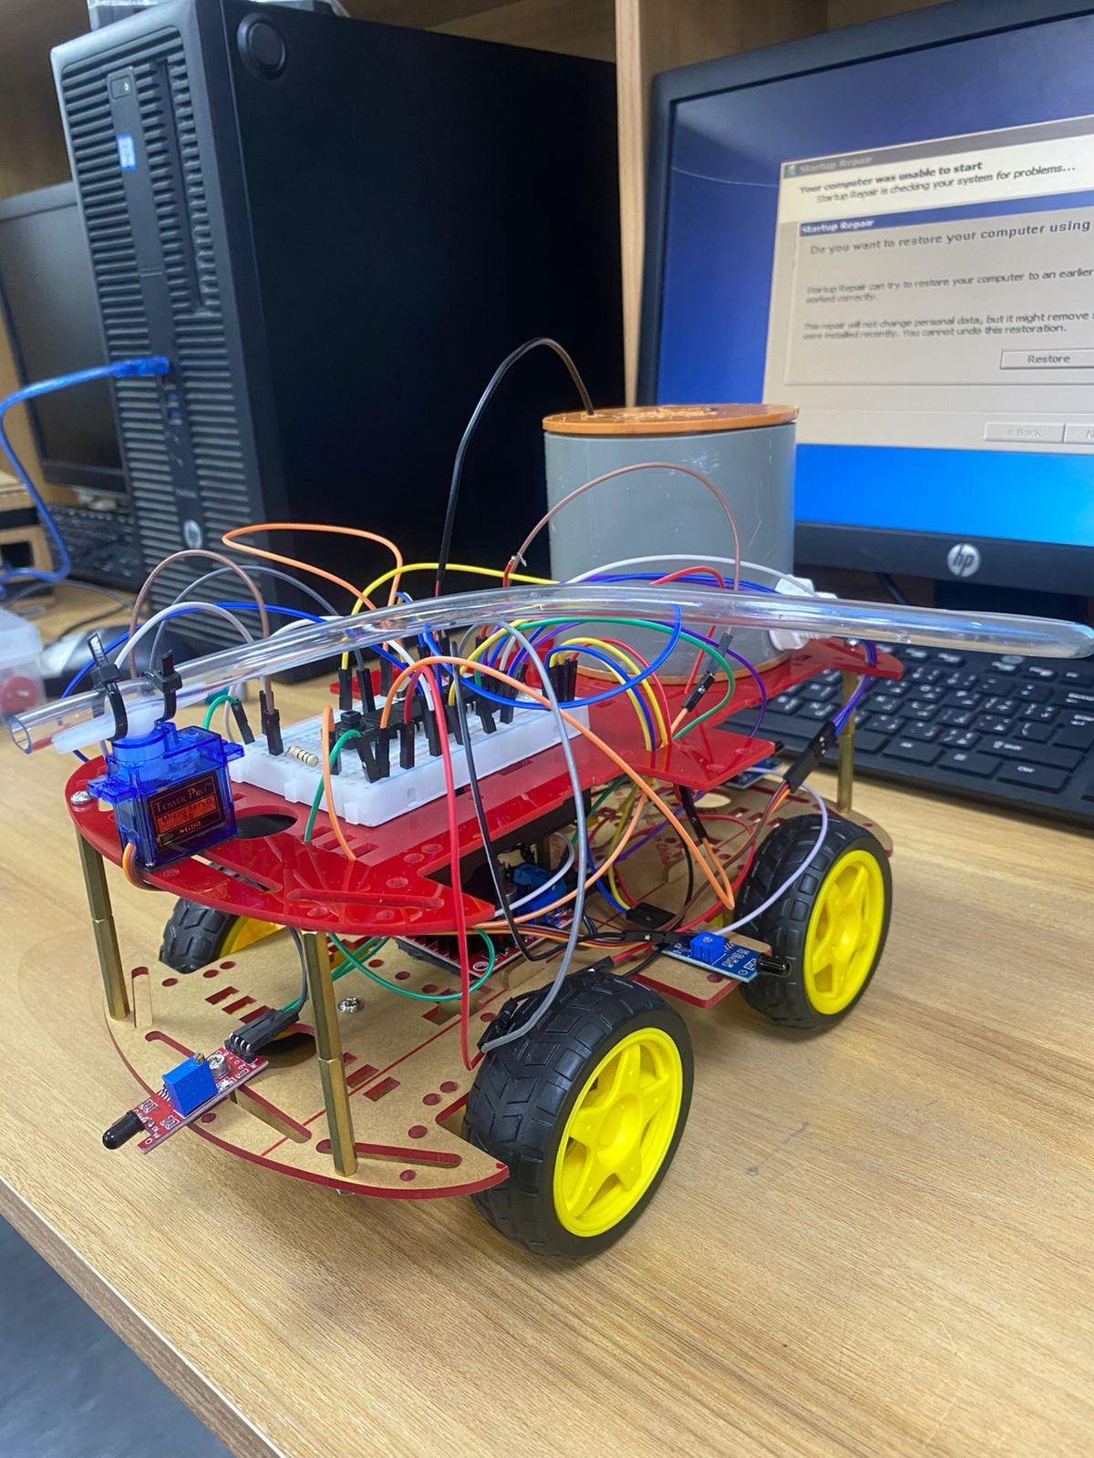
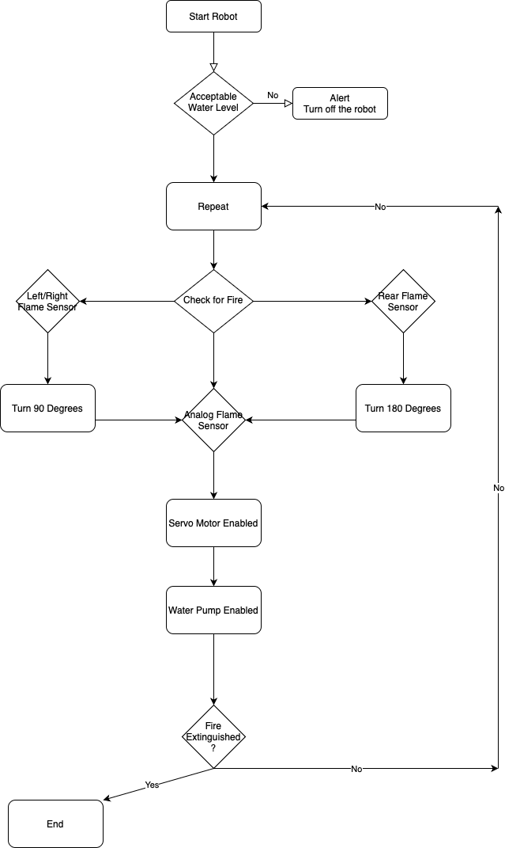
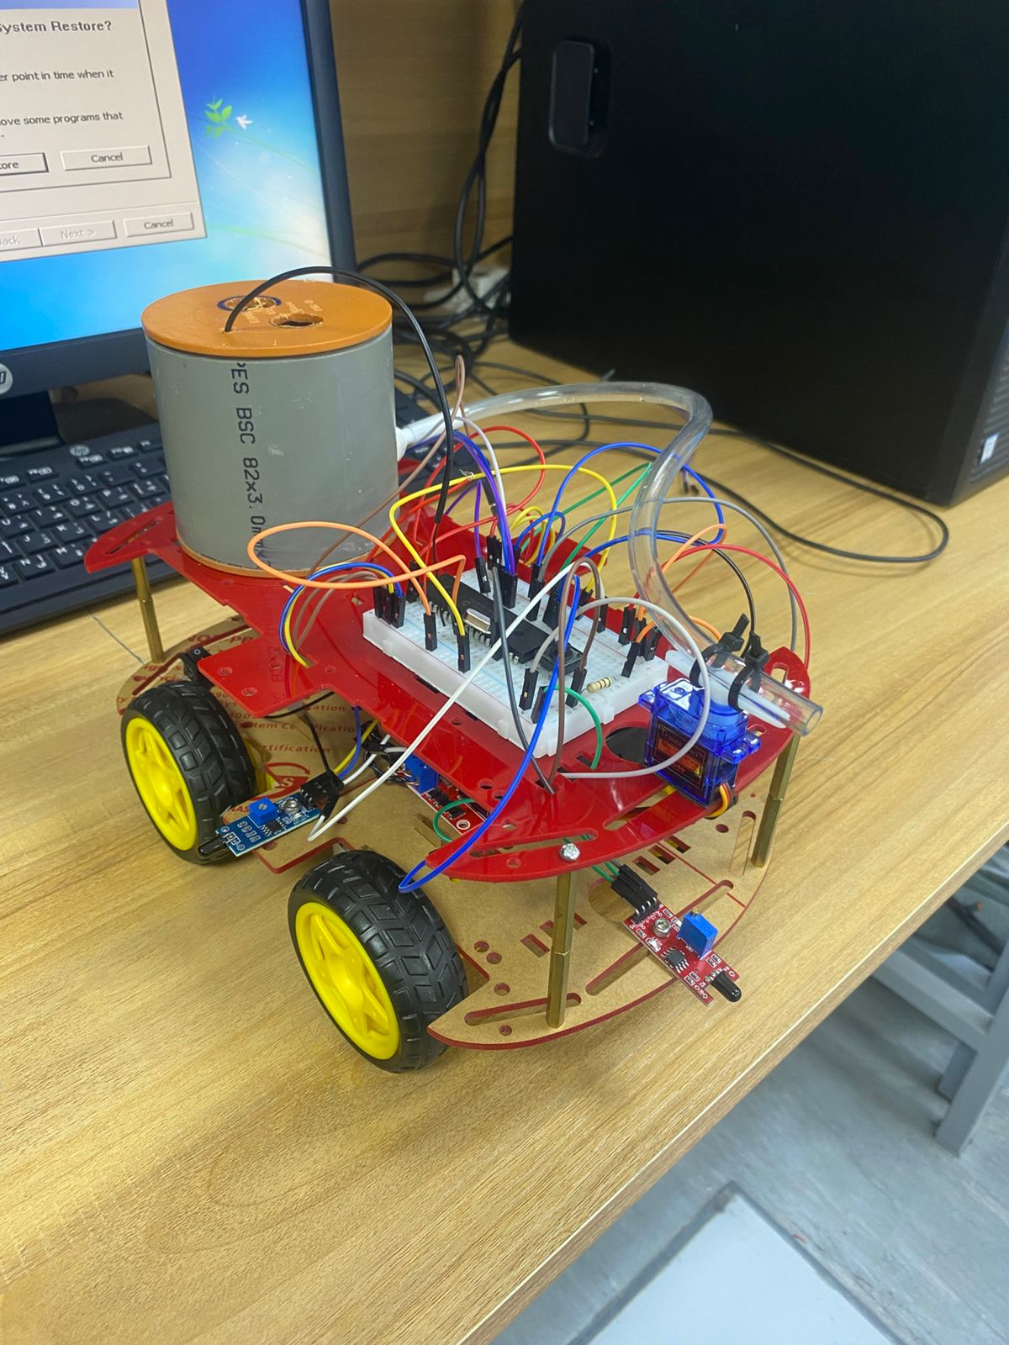
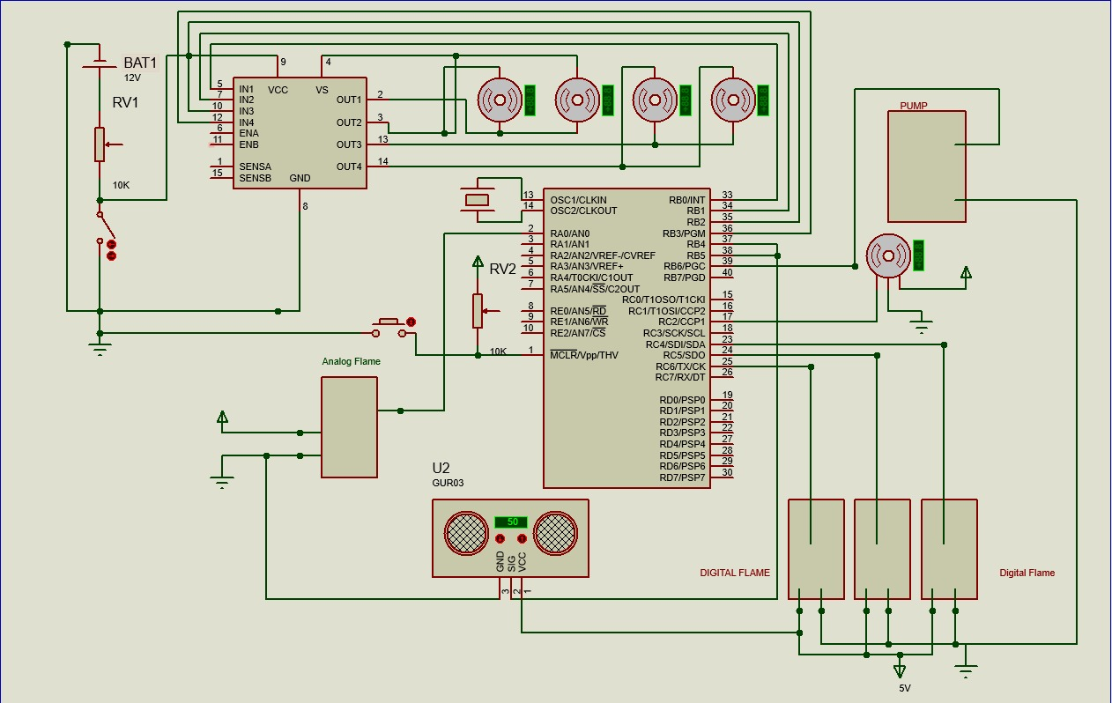
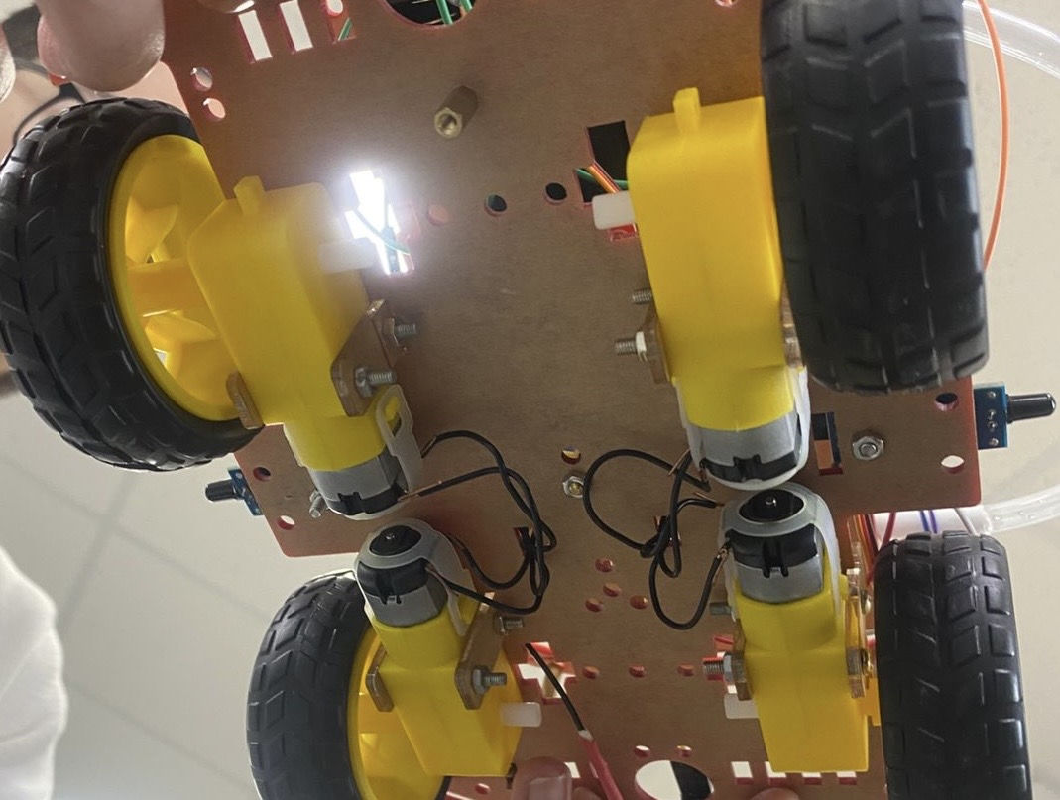
Firefighting Robot
A. Qudah, B. Barghothi, and E. Toffaha
Supervisor: Dr. Belal Sababha Embedded Systems Final Design Project, Fall 2024 King Abdullah II School of Engineering
Princess Sumaya University for Technology
Introduction
In this project, we developed a firefighting robot that detects and extinguishes fires. The robot uses four flame sensors to locate fires and stays stationary until a fire is detected. Once aligned with the flame, a servo motor directs water from a pump to extinguish the fire. The motors are powered by a 12V battery and controlled by an H-bridge, while the water pump and servo motor use a 5V from the H-bridge. All components are managed by a PIC16F877A microcontroller..
Results
The figures below show the firefighter robot.
Figure 3
Figure 4
Figure 5
Design
Figure 1: Software Design
Figure 2: Electrical Design
Conclusion
Overall, embedded systems have proven to be very effective and convenient. Our project successfully met its goal by detecting fire and extinguishing them with a water pump. The robot detects and extinguishes small fires, enhancing safety in controlled environments. This integrated approach ensures that our robot can swiftly respond to fire incidents, providing a reliable and autonomous solution for firefighting tasks. The project highlights the broader significance of embedded systems in improving safety and operational efficiency.

